Slide 1
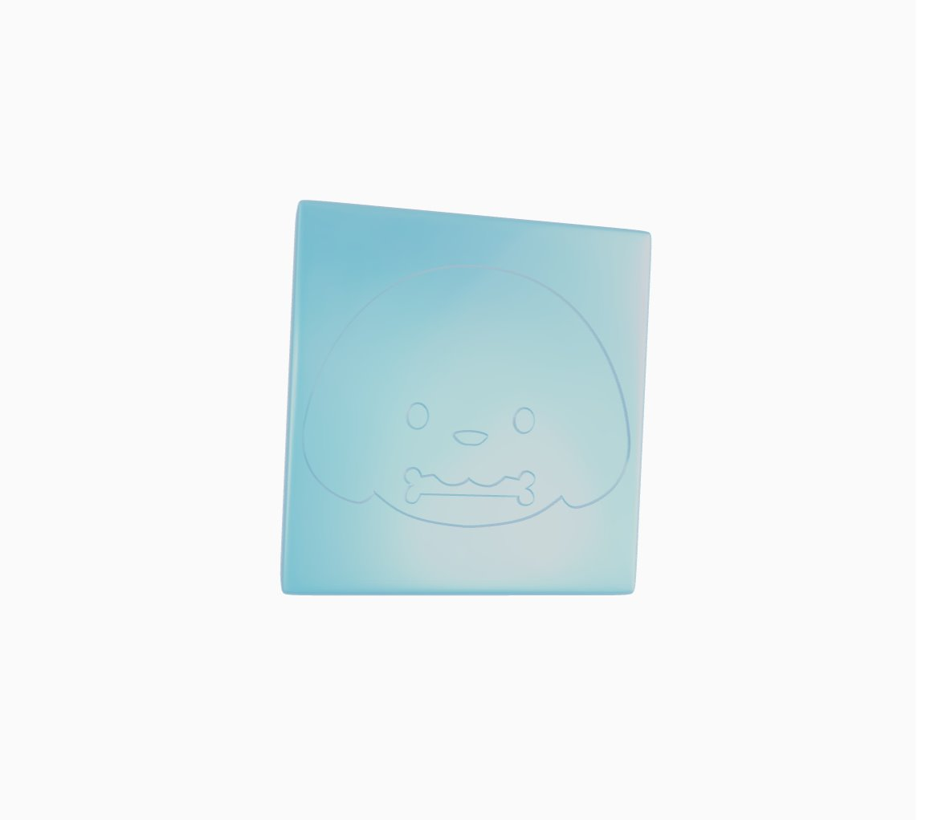
Retrieval Augmented Generation (RAG) Application Verba
ITAI 2372- AI Applications
By: Hashim Sayed Hoosini, Miguel Mora, Michael Garcia

Slide 2
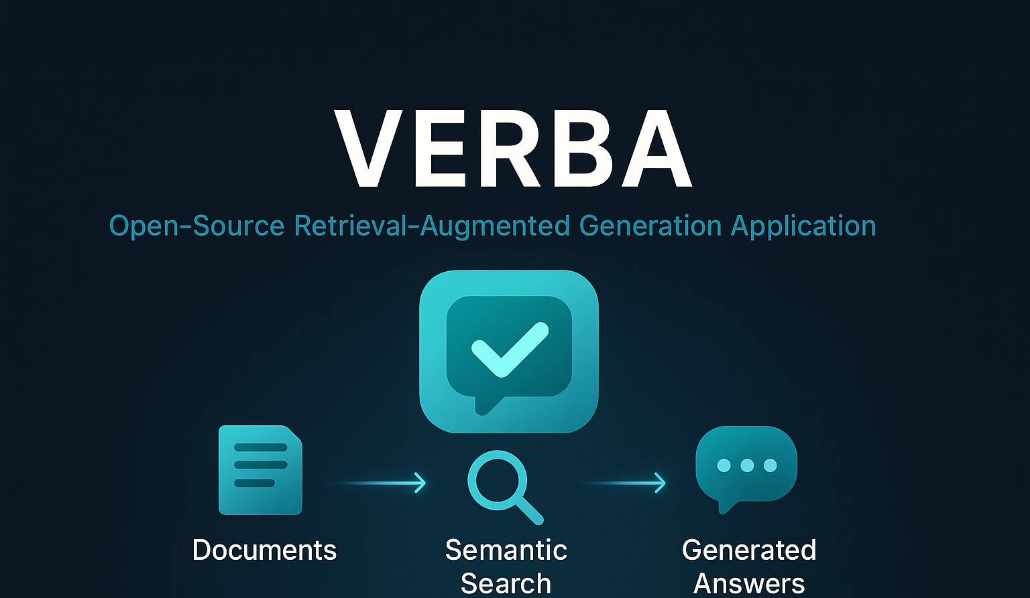
Presentation Outline
Introduction
What is Retrieval Augmented Generation (RAG)?
What is Verba and how it uses RAG.
Core Concepts
Chunking, Tokenization, embedding, and vectorization.
Modular Architecture
Overview of each manager on the RAG pipeline.
Tech Stack
Python, Weaviate, Docker, Ollama.
Setup and Demo
Installation, configuration, and usage.
Evaluation
Future directions and summary.

Slide 3
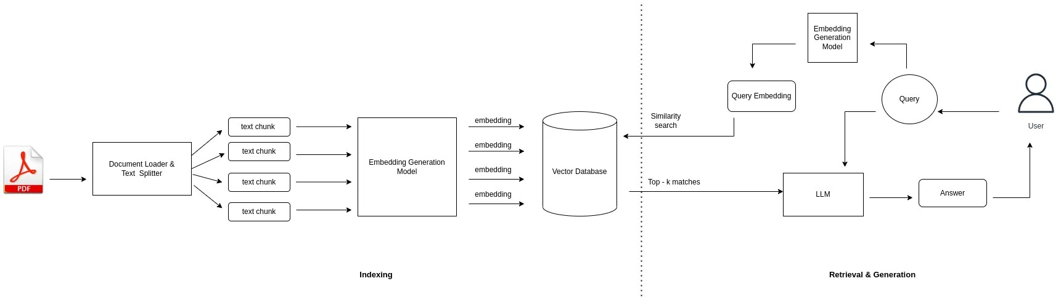
Retrieval Augmented Generation
A technique in AI that helps large language models (LLMs) give more accurate and grounded answers by pulling in real-world information before generating a response.

Slide 4
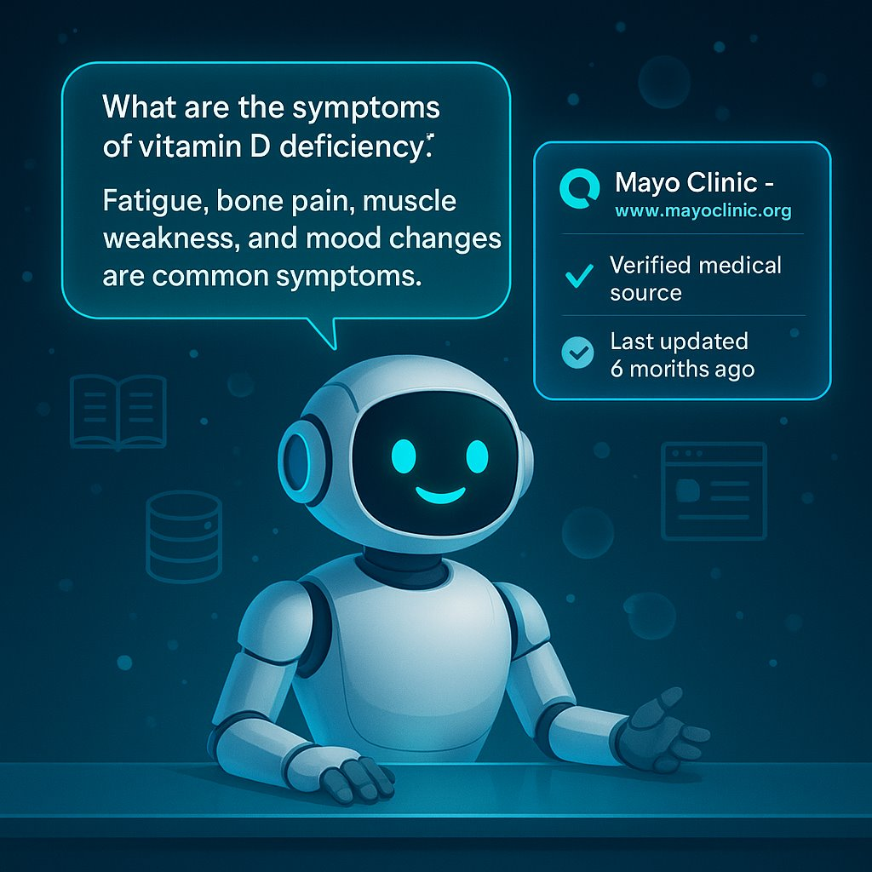

What is Verba?
Open-Source RAG Application
Built by Weaviate to showcase Retrieval-Augmented Generation (RAG)
Uses real documents to generate grounded, accurate answers.
Personalized Responses
Simplifies interaction between users and AI through a chat-style interface.
Answers are tailored to your data - no external sources, no hallucinations.
Ideal for private, domain-specific use cases.
Source Traceability
Every response includes a citation from your documents.
Users can verify exactly where the response came from.

Slide 5
Chunking
What is it?
Chunking means splitting a long document or paragraph into smaller, manageable pieces called chunks based on size or meaning.
Why is it useful?
Makes large text easier to process.
Helps AI models handle input within token limits.
Improves search and retrieval accuracy.
Example:
A 1000-word article might be split into ten 100-word chunks.
Long paragraphs become shorter sections, each with a fixed length or logical break.

Slide 6

Tokenization
What is it?
Tokenization means breaking text into smaller parts called tokens. These can be:
Whole words
Pieces of words
Punctuation marks
On average, 1 token = 4 characters, but this can change depending on the language or how complex the words are.
Example:
The sentence:
"The cat jumps over the dog." (22 characters) becomes about 8 tokens.
["The", "cat", "jump", "s", "over", "the", "dog", "."]

Slide 7
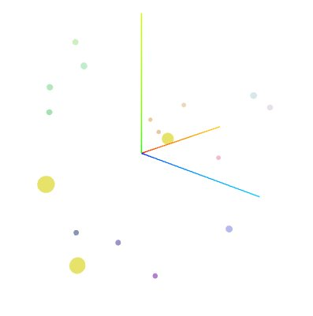
Vectorization: Creating Numerical Embeddings
What is it?
Vectorization turns text into numerical vectors that capture meaning. These vectors help AI understand relationships between words based on context, not just spelling.
In Verba:
Text splits into chunks.
Each chunk is turned into a list of numbers (called a vector).
Vectors are saved in a special database for fast searching.
Example:
The word "Apple" might look like [0.13, 0.14. -0.22,..]. These numbers help the AI link ideas like "Apple" with words like "fruit", "iPhone", and "Banana."

Slide 8
Indexing: Organizing for Fast Retrieval
Buffered Indexing
Improves performance by grouping text chunks together before processing them.
Sends the batch to the database all at once, improving speed and reducing extra work.
Vector Indexing
Saves pieces of documents as data points called vectors inside Weaviate, a vector database.
Retrieves results based on meaning and context instead of exact word matches.
Conversational Indexing
Tracks ongoing chat history and conversation flow.
Generates more context and coherent answers during multi-turn interactions.

Slide 9
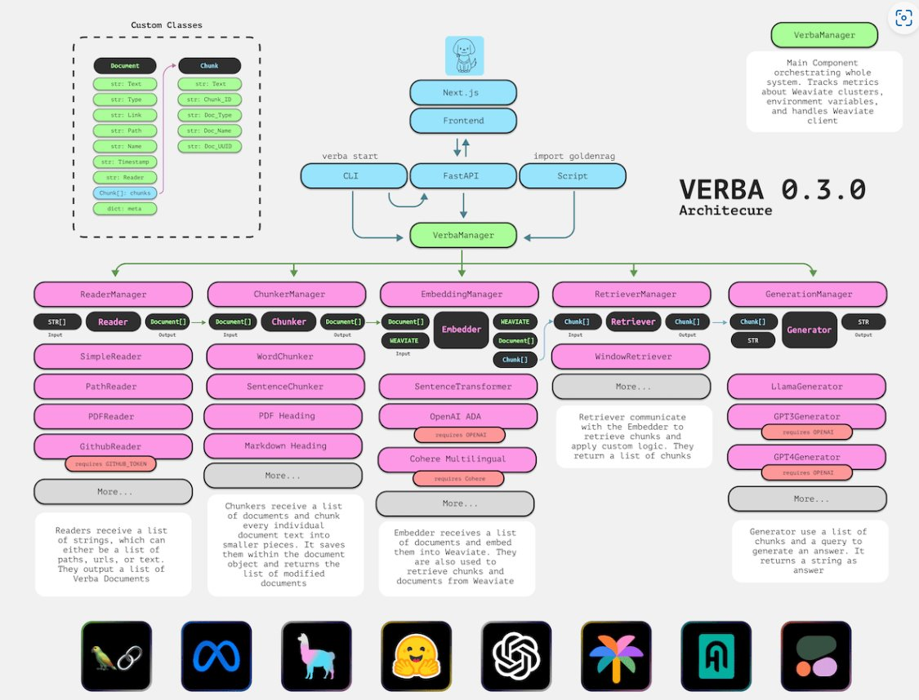
Modular RAG Architecture Part 1
Reader Manager
Loads and formats documents for processing.
Prepares content for chunking and embedding.
Chunker Manager
Splits documents into smaller, manageable pieces.
Helps improve retrieval accuracy by organizing content.
Embedding Manager
Converts chunks into numerical vectors using models like Mistral or Cohere.
Stores those vectors in a database for semantic search.

Slide 10
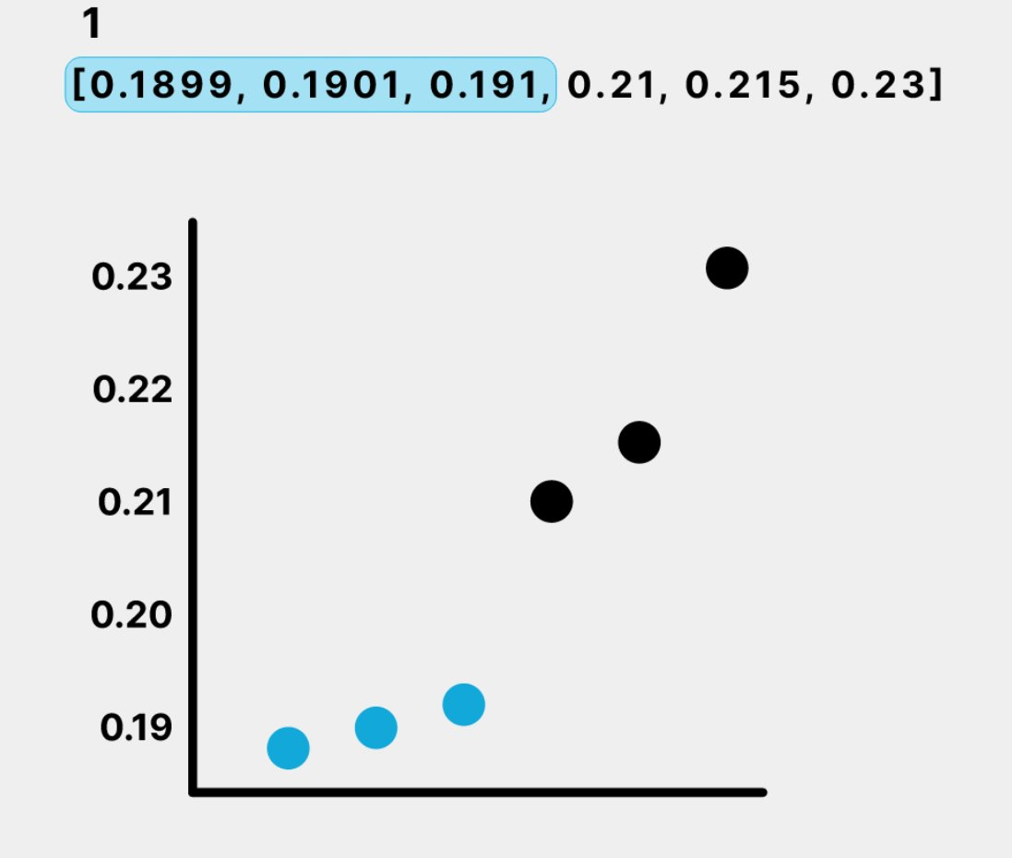
Modular RAG Architecture Part 2
Retrieval Manager
Finds the most relevant chunks based on a user's question.
Uses vector similarity to match meaning, not just keywords.
Generation Manager
Combines retrieved chunks with the question to create a response.
Uses a language model (like Llama3 via Ollama) to generate answers.

Slide 11

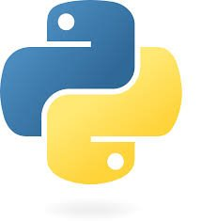
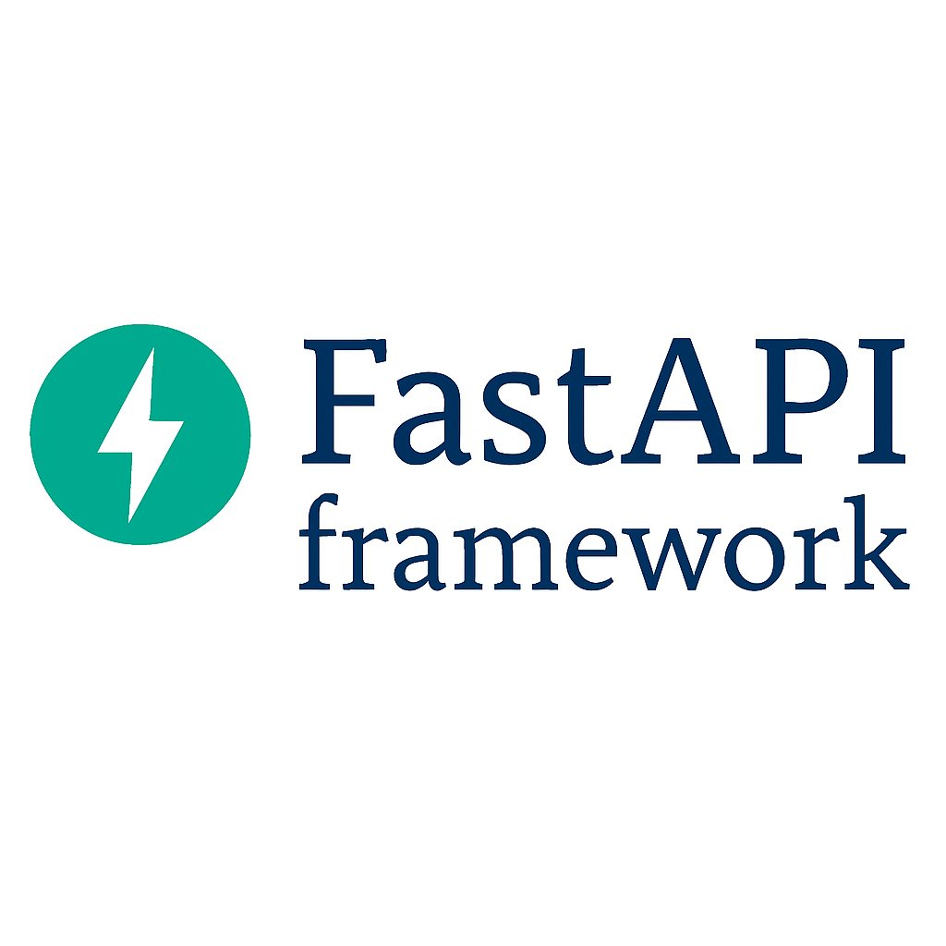
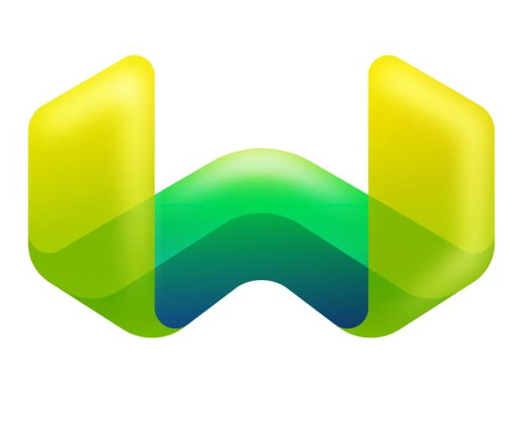

Application Stack: Verba's Technical Components Part 1
Frontend
React-based web interface running at localhost:8000.
Allows file uploads, chat interaction, and source viewing.
Backend
Python and the FastAPI framework.
Handles request processing, routing, and component coordination.
+
=

Slide 12
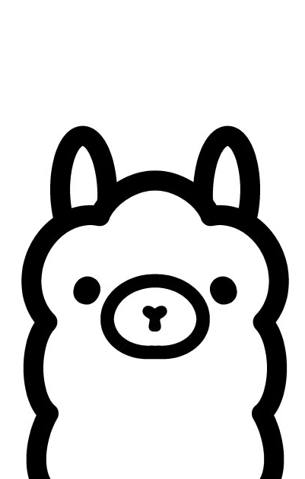
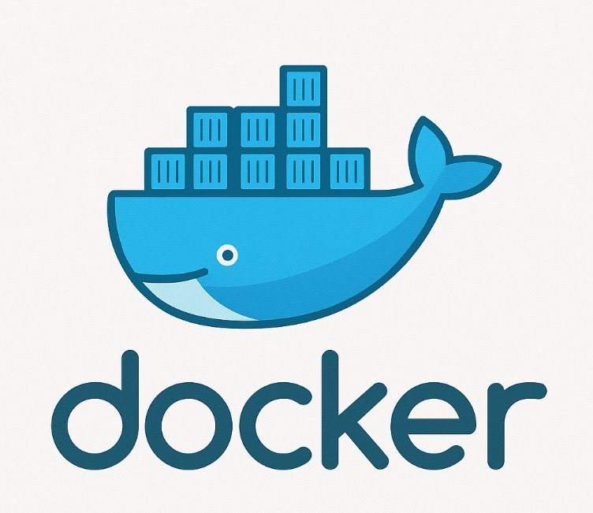
Application Stack: Verba's Technical Components Part 2
Vector Store
Weaviate store embedded document vectors for semantic search.
LLM Engine
Set Ollama to run language models locally (LLAMA3 in this project).
Supports integration with external providers as well such as Open AI and Cohere.
Docker
Docker packages Verba and its components (Weaviate & Ollama) into portable containers for easy setup and deployment.

Slide 13
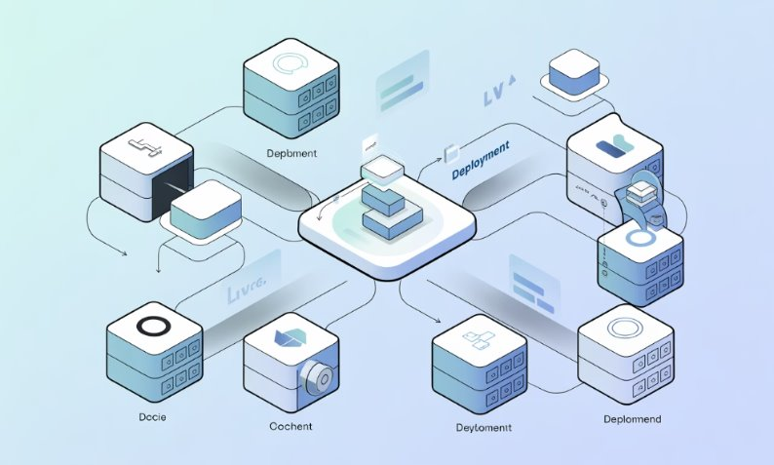
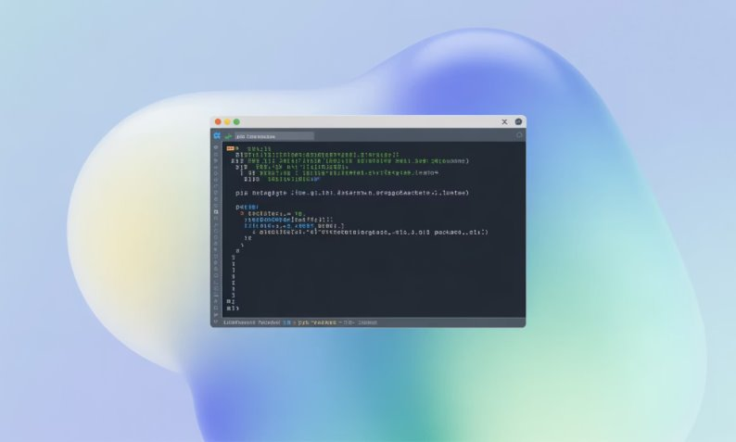
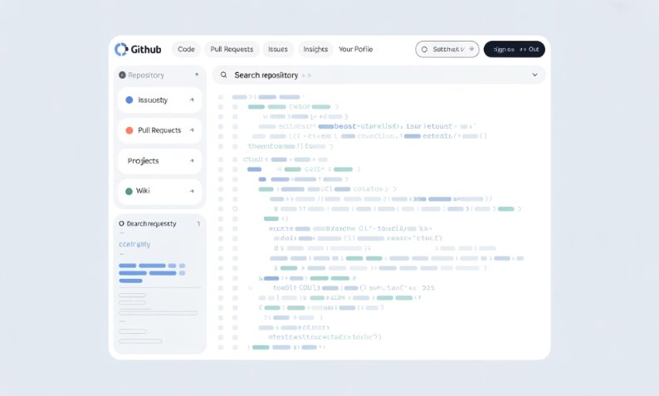
Installation Methods
Using Docker
Starts everything automatically and avoids setup conflicts.
Acess the app at the localhost:8000 in your browser.
Requires Docker Desktop, Git, and Ollama installed locally.
Using Pip
- Install Verba with: pip install goldenverba
Set up a Python environment and run: verba start
Opens Verba at localhost:8000 in your browser.
From Source
Clone Verba from GitHub and install dependencies manually.
Run each component separately for full control and customization
Ideal for developers who want to tweak or extend the codebase.

Slide 14
Verba Installation Process
Prerequisites
Docker Desktop: For containerization and service orchestra.
Git: For cloning the repository from GitHub.
Ollama: For running local LLMs
Python 3.10 +: For potential pip-based adjustments.
Installation Steps
Clone repository: https://git.com/weviate/verba.git
Set environment variables in the .env file.
Adjust the Docker-compose file if needed.
Run: docker compose up –d
Access Verba at localhost:8000

Slide 15
Using Verba: Step by Step
Start Verba
Launch Verba and choose the Docker option.
Import Data
Add data by selecting "Import Data" tab.
Select Files.
Choose files to upload (PDFs, Word docs, text files)
Process Files
Wait for chunking and embedding process to complete.
Query Your Data
Use the chat page to ask relevant questions about your documents.
Configure RAG Pipeline
Optionally adjust settings under the Config tab.

Slide 16
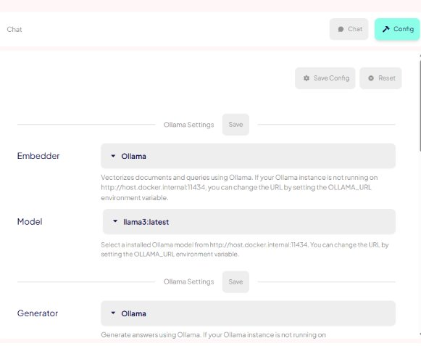
Configuration Options
Environment Variables (.env Setup)
OLLAMA_MODEL=llama3 – Sets Llama3 as the local language model.
VERBA_PORT=8000 – Defines the port for Verba's web interface.
LOG_LEVEL=debug – Controls how much detail appears in logs.
OPENAI_API_KEY=…/COHERE_API_KEY=… - Optional keys to connect external providers.

Slide 17
Future of Verba
What does the future look like?
Improved integration with local AI models like Ollama.
Providing users with greater privacy, flexibility, and control over documents and answers.
Allowing different people to use Verba simultaneously without sharing private data.
Expanding support for more document types like spreadsheets, audio, and code.
Adding smarter retrieval tools to improve answers accuracy.
Building a cleaner, more customizable user interface for different workflows.

Slide 18
Conclusion
Verba showcases how Retrieval-Augmented Generation (RAG) can personalize AI responses using your own documents.
Its modular, open-source design supports fast customization, local or cloud deployment, and transparent answer generation.
Verba's intuitive interface and traceable outputs highlight a user-centered approach to AI.
Successfully installing and running Verba proves its potential to transform document interaction through private, context-aware AI.

Slide 19
References
Slocum, V., & Schmuhl, E. (2024, March 7). Verba: Building an Open Source, Modular RAG Application. Weaviate.
https://weaviate.io/blog/verba-open-source-rag-app
Erzedka. (2025, February 3). Natural Language Processing (NLP): Definition and How It Works. Erzedka – Digital Media Technology.
https://www.erzedka.com/2025/01/natural-language-processing-nlp.html
Weaviate. (n.d.). Weaviate/Verba: Retrieval-Augmented Generation (RAG) Chatbot Powered by Weaviate. GitHub.
https://github.com/weaviate/verba?tab=readme-ov-file#api-keys

